Slide 1

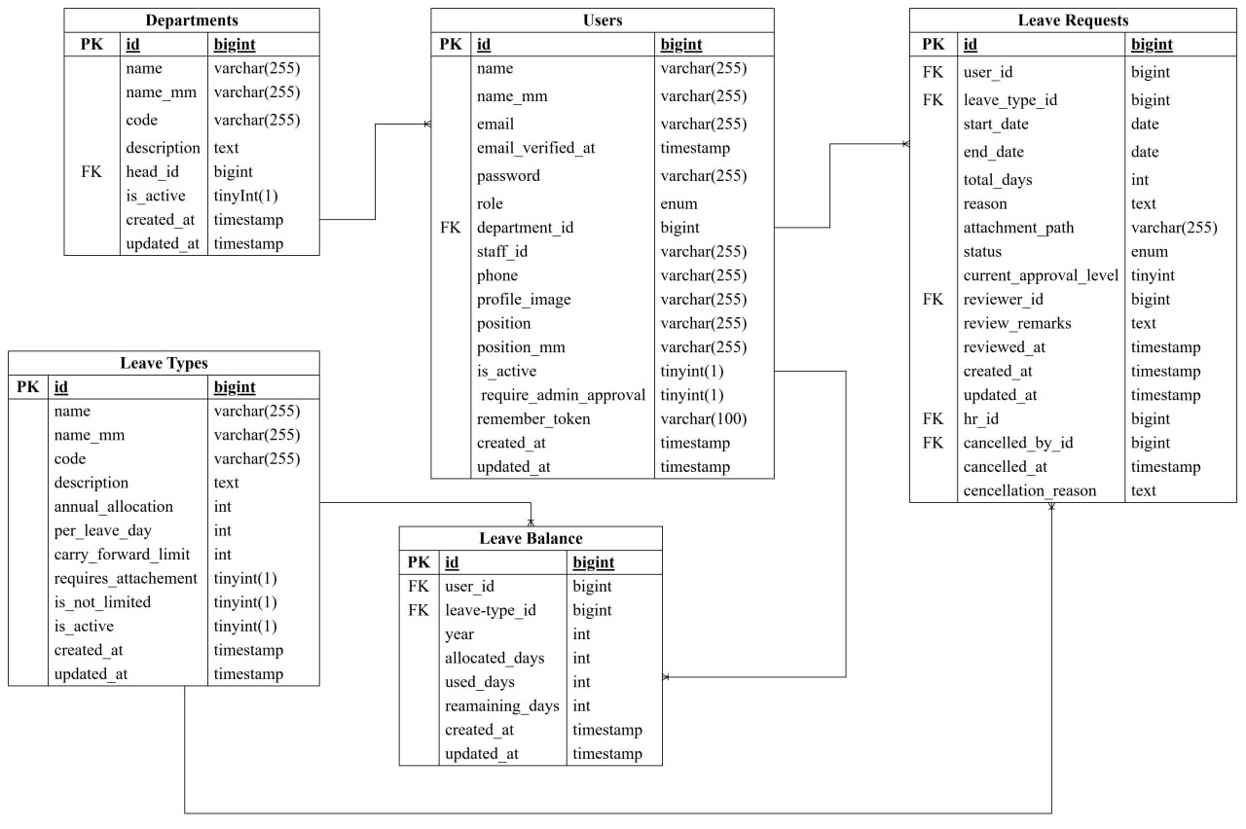
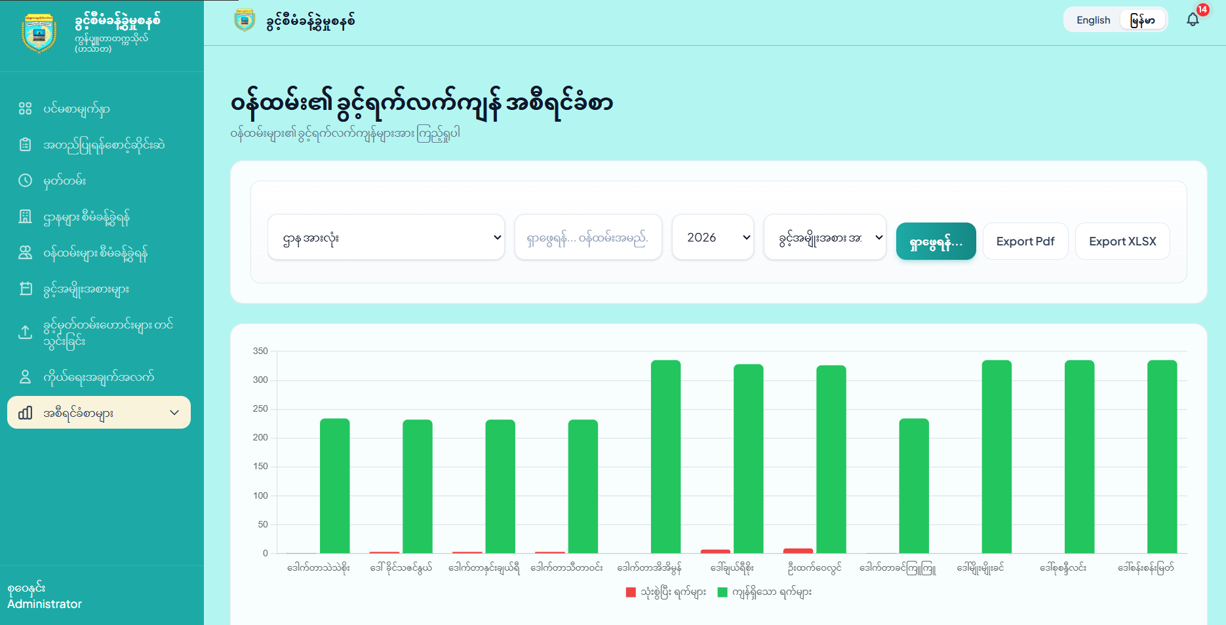






University of Computer Studies, Hinthada
Leave Management System
Database Design
System Implementation
Development Technology
HTML5 structures web content clearly for display on modern browsers.
CSS3 styles web page elements with modern, visually appealing layouts.
JavaScript ES6+ adds modern syntax and dynamic functionality to applications.
Tailwind CSS provides utility classes to style interfaces directly inside markup.
Laravel is an elegant PHP framework built for scalable web development.
MySQL securely manages structured application data using relational database tables.

